Slide 1
Forest Navigation UAV

Slide 2
Evidence-driven results (training + evaluation)
Thodoris Evangelakos
INF-412 27/2/2026

Slide 3
eval/mean_reward
Mean episodic reward during evaluation (EvalCallback)
eval/success_rate
mean success during evaluation (requires is_success)
Definitions used
safety/collision_mean
average collision signal
safety/shield_active_mean
shield active fraction per step

Slide 4
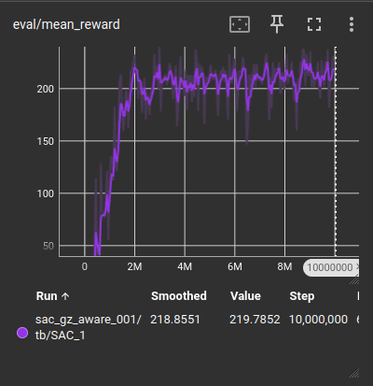
Evaluation return climbs fast then plateaus
- Big jump in first ~2M steps
- Stabilizes ~200-230 after that (steady policy regime)

Slide 5
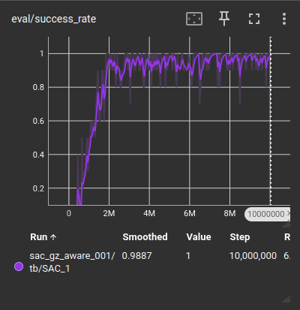
Success rate reaches near-1.0 and stays high
- Ramps to ~0.95-1.0 by ~2M steps
- Occasional dips from randomized eval episodes

Slide 6
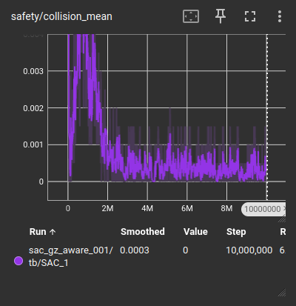
Collisions collapse after early training
- High early collisions during exploration
- Drops sharply after ~2M steps and remains near zero

Slide 7
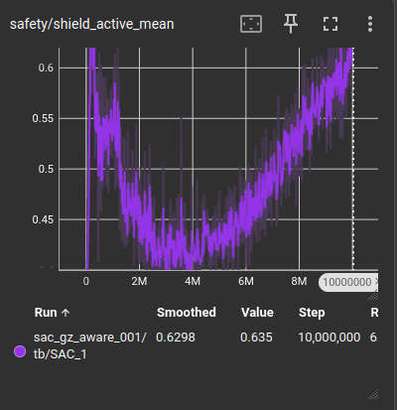
Shield activity evolves as policy becomes aggressive
- Early: shield saves immature policy
- Mid: fewer interventions (policy learns clearance)
- Late: interventions rise as policy pushes tight margins

Slide 8
Policy pushes performance, shield enforces constraints
- Even when shield activity rises late, collisions remain low
- Supports the design goal: aggressive policy + hard safety layer

Slide 9
Thank you for your attention!

